Slide 1
Escape the Distributed Monolith
“Your scientists were so preoccupied with whether or not they could, they didn't stop to think if they should.”
Ian Malcolm, Jurassic Park

Slide 2
Who are you?
Software Developer for more than 20 years
Worked mainly for ISVs
Reuters, SunGard, Misys, Huddle
Worked for a couple of MIS departments
DTI, Beazley
Microsoft MVP for C#
Interested in architecture and design
Interested in Agile methodologies and practices
No smart guys
Just the guys in this room

Slide 3
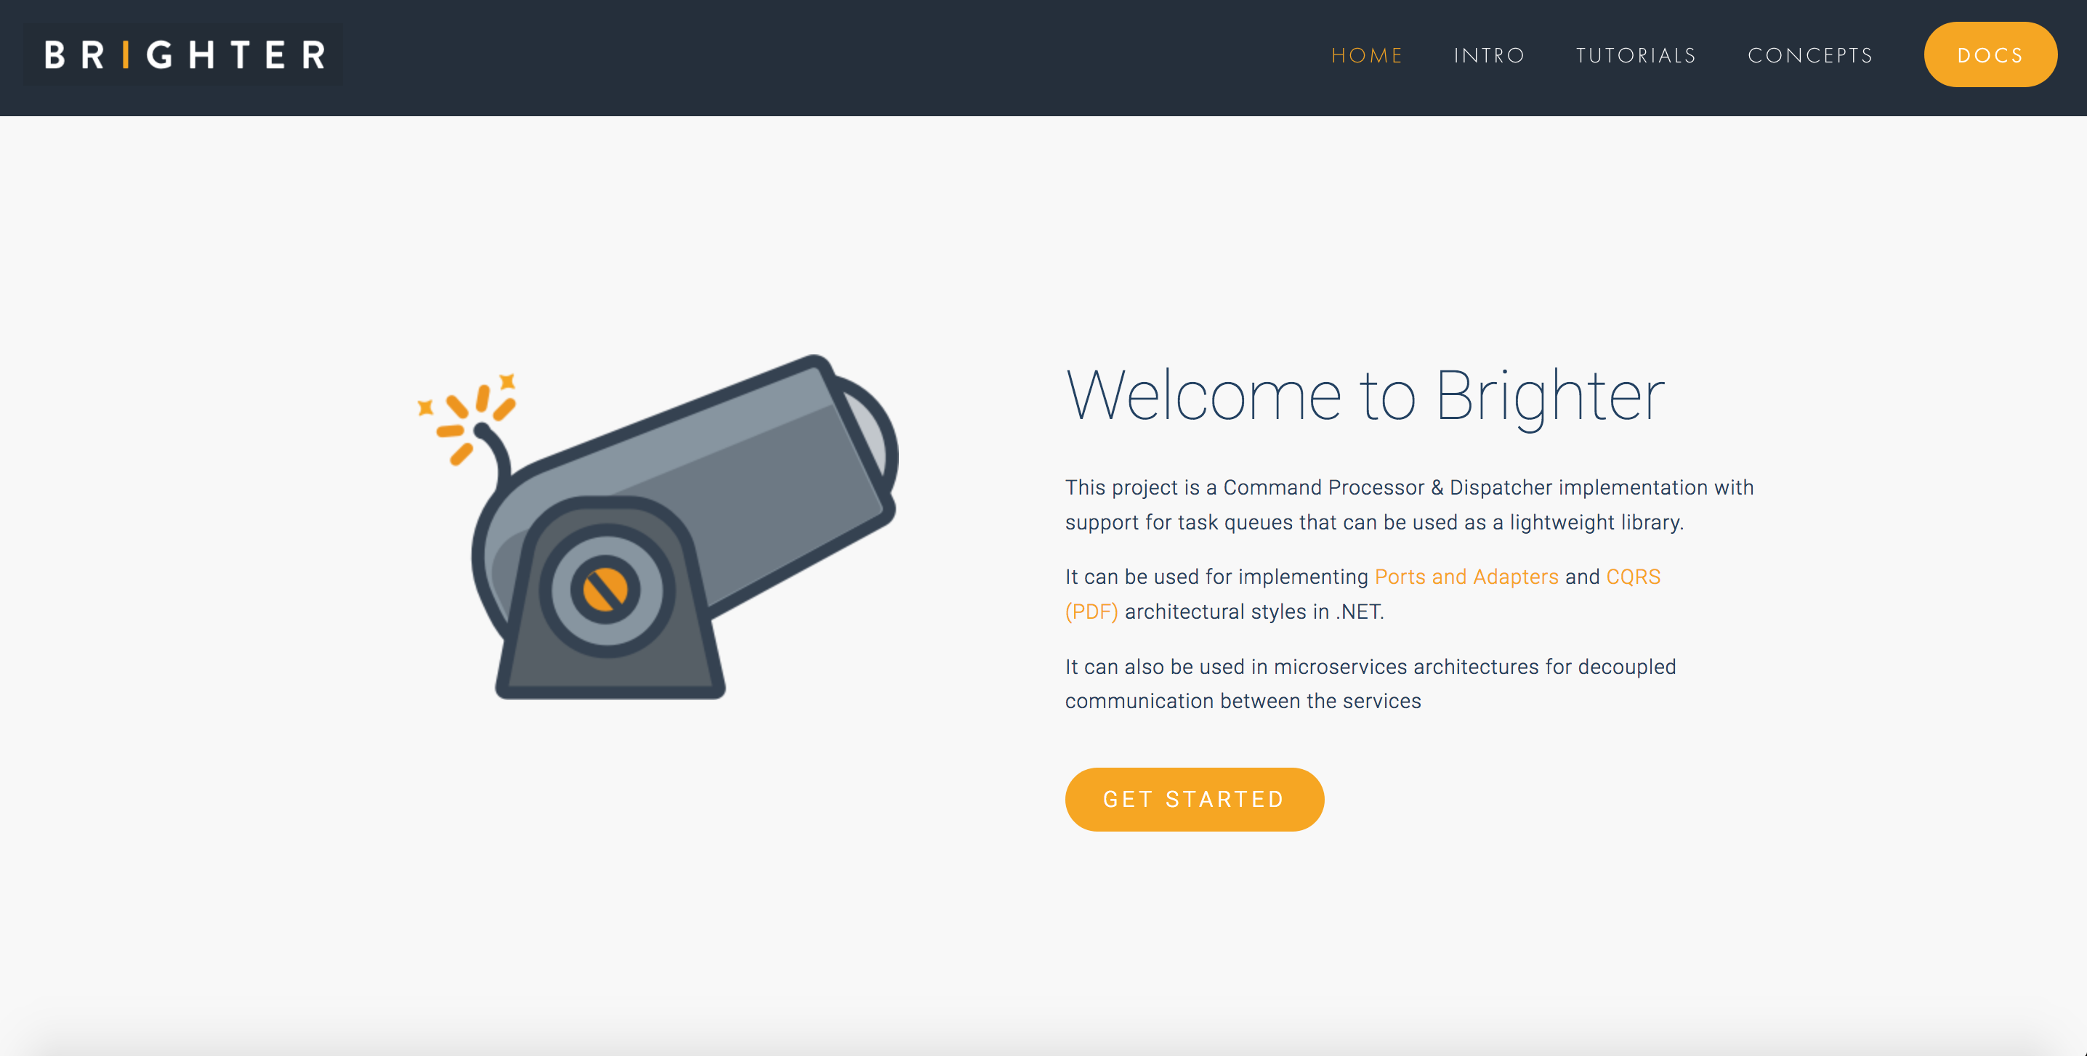

Slide 4
Agenda
Monolith to Microservices
Monolith to Microservices Distributed Monolith
Containers to the Rescue! Or not.
Decoupling Services with Events
Reference Data, EDA’s secret sauce
Q&A

Slide 5
I know nothing about hotel software!
Notes:
I use examples from domains I have not worked in primarily because it means that it is clear I am not referring to a current or future employer
It should also be simpler because I know as little as most of the audience about this domain

Slide 6
Monolith to µservices

Slide 7

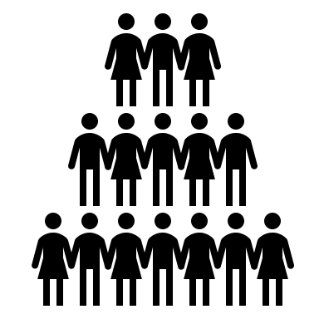
Direct
Bookings
Credit Card Payment
Credit Card Payment
Hotel Software
(Monolith)
Channel Manage-ment
Notes:
We use µservices to partition a system so that we can scale
We want to scale our development organization, and want teams to be able to release on independent schedules
We will gain benefits around easier reasoning, or change, and being able to scale different workloads individually – but all of these can be achieved other ways. If I just want to reason about my software better I can use modules, layers, abstraction and information hiding
I can run separate processes for different workloads, but have all those processes talk to the same Db, share the same domain model etc. and not be a microservice, just a distributed system. Two separate apps does not imply two microservices.
Generally, the trigger for µservices is that the product grows beyond the two pizza team and we need to start working on independent schedules.

Slide 8

When consumers depend on an API they want it to be stable
Direct
Bookings
Credit Card
Payments
Housekeeping
Channel Manager
API
API
API
API
Db
Db
Db
Db
When one service relies on another, it wants the API to be stable
Broker
We seek to create stable contracts between services by using stable partitions

Slide 9
Partitioning with Business Capabilities
A capability models what a business does that provides value for customers – its externally visible behaviour
It is a noun, (sometimes verb + noun), and always has an outcome.
It tends to have a strong alignment with business processes found via value-chain mapping or event storming
Notes:
How do we partition?
One option is to adopt the SOA strategy of a business capability
Rate Insurance Risk or Bill Customers are examples of business capabilities.
How people implement these, with people procedures and technology, is a business process.
A business consists of a network of interacting capabilities.
A capability is stable longer than a process.
As such we architect against capabilities not processes.

Slide 10
Level 1: Foundational Capabilities
Operational Capabilities
How we Deliver Service, Generate Demand, Create Products etc.
Environmental Capabilities
How we interact with Customers, Regulators etc.
Level 2: Capability Groups
Map to organizational accountability ownership
Claims, Underwriting, Housekeeping, Concierge
Level 3: Business Capabilities
Something the capability group does to provide value
Claims Assessment, Risk Rating, Kitchen, Check-In

Slide 11
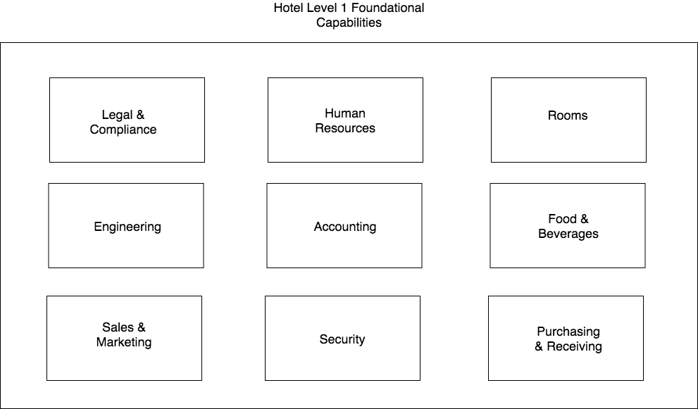

Slide 12
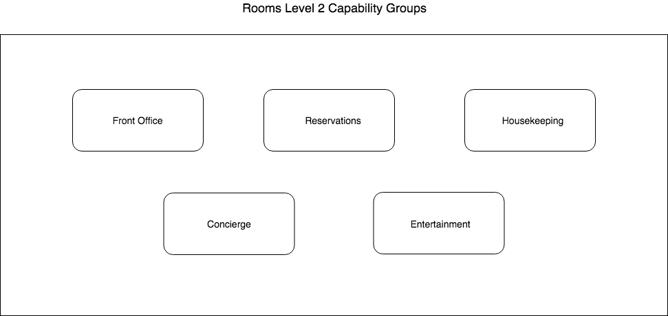

Slide 13
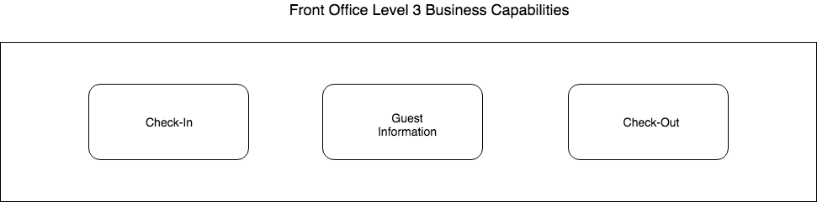
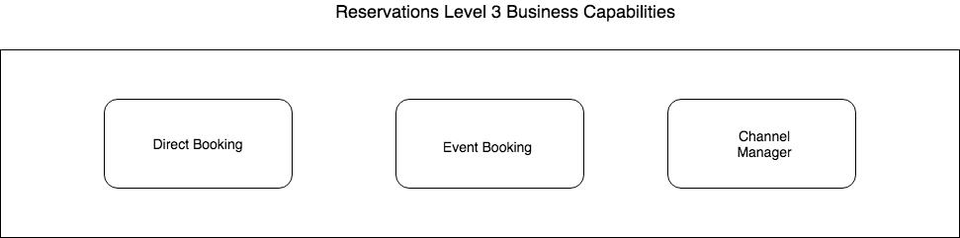
Notes:
Front Office
-- Check In: Check guests in
-- Guest Information: Information about guest preferences, purchases made during stay etc.
-- Check Out: Check guests out
Reservations
-- Direct Booking: Booking be individuals through a website, including an aggregator
-- Event Booking: Booking for corporate events on account
-- Channel Manager: Controls which channels we have direct booking on, manages availability of rooms and rates across that estate. Handles promotions

Slide 14
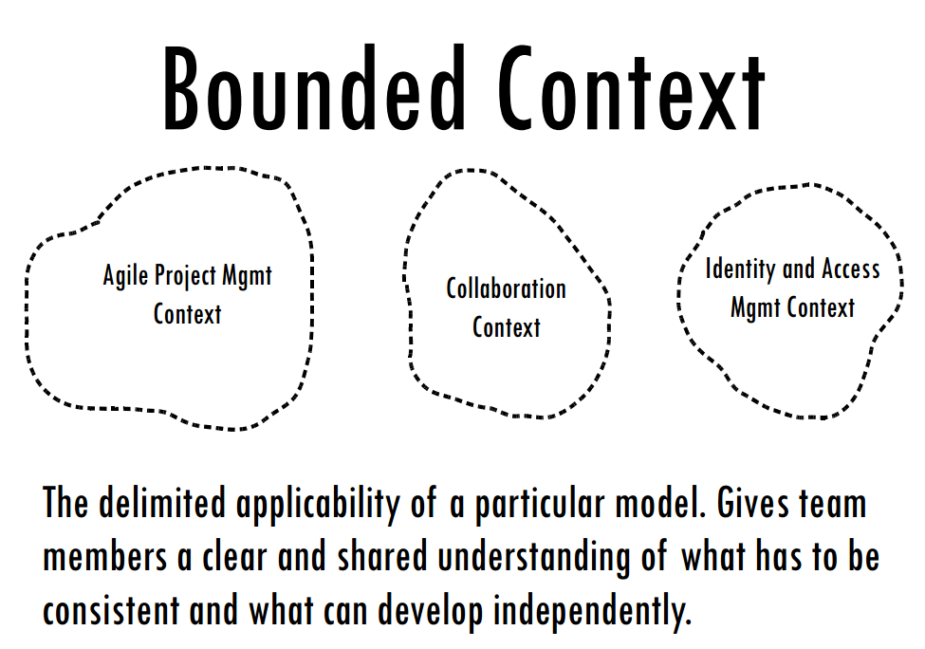
Partitioning with Bounded Context
Image from Vaughn Vernon, Implementing Domain Driven Design
Notes:
Multiple models are often in play on a project
Seeking to combine or reconcile those models causes pain
Instead we limit our modeling of a domain to a context, often aligned with a business capability.
A domain model is only valid within that context
Terms of a ubiquitous language have meaning within a context
XP had a notion of metaphor for architecture, an idea that helped everyone envisage the domain.
Most folks just replace metaphor with ubiquitous language today
A Bounded Context is not a module
A Bounded Context is a CI boundary
It is worth noting that although a Bounded Context is a boundary for model consistency, it is not necessarily one bounded context per process. In principle you could have multiple bounded contexts that you ship within a single process, provided that the boundary was explicit i.e. a module or layer boundary. So whilst a bounded context is **useful** it is actually a related concept to microservices that can help finding boundaries (and a bounded context should not be in multiple microservices) but is not strictly the sole way of finding the boundary.
Multiple Models
Explicitly define the context within which a model applies. Explicitly set boundaries in terms of team organization, usage within specific parts of the application, and physical manifestations such as code bases and database schemas. Keep the model strictly consistent within these bounds, but don't be distracted or confused by issues outside.
When we talk about a ubiquitous language the terms only have meaning within a context. Thus the context is a linguistic boundary.
When we model use cases or scenarios, we will find it easier to model those elements, by CRC card sessions, or on the whiteboard, to restrict our discussion to one context. The classes that we define should deal with the problem context. They often do this naturally. Generally we build systems for requirements from one source, not from many. The attempt to model across requirements from different sources is what creates heartbreak from complexity – the canonical data model.
A context is analogous to the Single Responsibility Principle in OO. We want our objects to have only one reason to change. Multiple competing requirements from different context can cause an issue, because they create responsibilities for use cases that are widely divergent and thus lead us to have multiple sources of change.
For example, I once built an underwriting system that allowed user-definition of new products, where a product was essentially the data required for a pricing model for a selection of policy clauses that a business could purchase. This was modeled within the same context, underwriting as the workflow around a policy application – the principle being that all the choices on the product had relevance when processing the application. This proved problematic because the model to make the product user definable made it more complex than a static model, and the use cases were unrelated. It would have been better to have created a context for authoring products that could publish a product definition to underwriting, licensing and rating, instead of trying to create one that could be used by underwriting directly. The smell that rating and licensing required publication but that underwriting did not could have led to greater understanding here.
The party model is a classic example of an object that is designed for many contexts and thus has no meaning within any context.
Look for terms in the model that are not discussed with the domain experts – they are probably alien. Look for terms that are disagreed upon by domain experts: “you mean this, but I mean that” These are often a smell that the two domain experts care about separate contexts
BOUNDED CONTEXTS Are Not MODULES
The issues are confused sometimes, but these are different patterns with different motivations. True, when two sets of objects are recognized as making up different models, they are almost always placed in separate MODULES. Doing so does provide different name spaces (essential for different CONTEXTS) and some demarcation. But MODULES also organize the elements within one model; they don't necessarily communicate an intention to separate CONTEXTS. The separate name spaces that MODULES create within a BOUNDED CONTEXT actually make it harder to spot accidental model fragmentation.
A Bounded Context is a CI boundary
A bounded context is treated as a CI boundary, because we want the model to be consistent and not fragment
Within a bounded context we need: an automated build, automated test suites, continuous deployment
By implication – we do not need to do CI, automated testing, or continuous deployment across bounded contexts
A Bounded Context may be aligned with a Service
SOA boundaries are about business capabilities. A business capability tends to be aligned with the work of one department who have a shared understanding of model concepts. So in an insurance company Claims and Underwriting are separate departments with separate languages, and different use cases, so they have both differing models, but also tend to have separate business capabilities or services.
It may be more granular though. We may find that there are specialist areas of a business capability, such as rating within underwriting that might not be their own business capability – they don’t publish events to other Services for example – but are a separate context because their language and model is more specialized than the whole. We might find these are separate autonomous components within the logical service boundary, and have a separate set of use cases, hinting at their context.

Slide 15
Breaking up the Monolith
99 Ways To Leave Your Lover

Slide 16
Asset Capture
Monolith
Service
Cut & Shunt
Db
Data Autonomy
Db
Notes:
You can identify bounded contexts through an exercise known as Context Mapping. But when you break up a monolith we would expect them to have a **shared kernel** relationship.
The Core Domain – most value but also should be most likely to change and thereby benefit from autonomous release. Start with highest value, to ensure that you can get most benefit for your efforts and ensure continued buy in. We improved productivity three times, yeah! If you start with lowest risk you may learn, but you may not realize enough benefits that anyone cares about your initiative. In fact you may just increase cost but not productivity because your low-risk app does not have frequent enough change to amortize your costs of distribution against.
Break in-process dependencies. If an in-process call crosses the context boundary I must replace it with IPC. We will return to this, crux of the talk
Cut & Sbunt takes the bounded context out of the monolith. You just copy this code at this point, don’t opt for a rewrite (theory of constraints). Put it behind a new API. Might be a rewrite, or new because new API already existed, or a new version of the Old API so that you can route traffic to it. Now you can begin routing traffic away from the monolith towards the microservcie. Once all traffic passes to you, the you can declare autonomy.
A key step here is to ensure that you now **own** the data and can move it to your own Db
You might need reference data at this point.

Slide 17
Monolith
Service
Service
Db
Db
Db
Notes:
Repeat ad nauseam

Slide 18
Monolith to µservices Distributed Monolith

Slide 19
Getting work done in a Monolith
API
Presentation
Direct
Bookings
Credit Card
Payments
Accounts
Housekeeping
Channel Manager
Domain
ORM
Data
Db
Notes:
In a typical monolithic application, we might divide up our system into three layers.
Presentation: The widgets, in this case our HTTP API, but might it might have been server-side rendered HTML etc.
Domain: The application and domain logic
Data: Access to our persistent storage
Let us imagine that we have a request for a direct booking on account. To service this request, we would probably call some application logic in a service/command in direct bookings (1). The application logic there would load the data we needed to complete the operation, so the account details with the credit card information 2-5), so that we could then take a credit card payment (6-7). In turn we would then save the direct booking (8) andl probably call Housekeeping and Channel Manager to update their records of the number of available rooms.

Slide 20
Booking is my new µservice.
But how do I call the accounts or payment code in the monolith now?
def add_new_booking(self, new_booking):
self. _validate_booking(new_booking)
booking= Booking(new_booking.lastname, new_booking.firstname, new_booking.reservation, new_booking.amount, new_booking.credit_card)
self._booking_repo.add(booking)
credit_card = self._accounts.get_card_details(booking.account)
paid = self._payments.take_payment(booking.amount, credit_card)
if paid:
….
else:
….

Slide 21
Request Driven Architecture
Direct
Bookings
Credit Card
Payments
Accounts
Housekeeping
Channel Manager
API
API
API
API
API
Db
Db
Db
Db
Db
Broker
Notes:
Temporal coupling is the problem that in order for us to make a Direct Booking the Channel Manager needs to be working. If we cannot update the channels, we do not take the customer’s booking. But of course this is problematic (1) Our uptime for our Direct Bookings Service is the product of the uptime of all the services that it calls (2) The channel manager may depend on external channels that have low uptimes and if so our direct bookings service becomes only as available as the worst availability of our channels (in fact worse as it is the product).
And would the business prefer: we can take a booking but might risk over-booking because one of our channels offers a room that we have already sold, or that we don’t take any bookings because we cannot guarantee against over-booking. For most business it is arguably the former
The server must be available when you call.
if I make a phone call, and you are not there I am shit out of luck. RPC is a phone call, direct communication between two participants and can be frustrating if you get a busy tone or no one answers. (nowadays we may leave an answer phone message, or send a text, but this is messaging not RPC). We will come to that later.
Pooling of resources can help here – one of anything can fail, so you need multiple servers
To avoid the client now having to know about where a server lives, which again defeats concept of RPC, then you have to use service-discovery in your runtime, so that location is hidden to caller. Good idea anyway, even if location transparency not our goal, not to have a fixed location.
Not true of decoupled invocation i.e. messaging of course.
“... the degree to which the sending and handling of a message are connected in time. If a sender is dependent on a receiver being available when a message is sent, we have high temporal coupling... Processes whose activities are strictly ordered or whose results carry forward, leaving subsequent activities unable to start until a response to a prior request has been received, are similarly temporally coupled. “ Ian Robinson

Slide 22
Temporal Coupling

Slide 23
Request Driven Architecture
Direct
Bookings
Credit Card
Payments
Accounts
Housekeeping
Channel Manager
API
API
API
API
API
Db
Db
Db
Db
Db
Broker
Notes:
Temporal coupling is the problem that in order for us to make a Direct Booking the Channel Manager needs to be working. If we cannot update the channels, we do not take the customer’s booking. But of course this is problematic (1) Our uptime for our Direct Bookings Service is the product of the uptime of all the services that it calls (2) The channel manager may depend on external channels that have low uptimes and if so our direct bookings service becomes only as available as the worst availability of our channels (in fact worse as it is the product).
And would the business prefer: we can take a booking but might risk over-booking because one of our channels offers a room that we have already sold, or that we don’t take any bookings because we cannot guarantee against over-booking. For most business it is arguably the former
The server must be available when you call.
if I make a phone call, and you are not there I am shit out of luck. RPC is a phone call, direct communication between two participants and can be frustrating if you get a busy tone or no one answers. (nowadays we may leave an answer phone message, or send a text, but this is messaging not RPC). We will come to that later.
Pooling of resources can help here – one of anything can fail, so you need multiple servers
To avoid the client now having to know about where a server lives, which again defeats concept of RPC, then you have to use service-discovery in your runtime, so that location is hidden to caller. Good idea anyway, even if location transparency not our goal, not to have a fixed location.
Not true of decoupled invocation i.e. messaging of course.
“... the degree to which the sending and handling of a message are connected in time. If a sender is dependent on a receiver being available when a message is sent, we have high temporal coupling... Processes whose activities are strictly ordered or whose results carry forward, leaving subsequent activities unable to start until a response to a prior request has been received, are similarly temporally coupled. “ Ian Robinson

Slide 24
Behavioral Coupling
Notes:
“...the degree to which parties share assumptions regarding behaviors, more specifically, to the implications of assigning the twin responsibilities for determining what action to execute and how to execute that action to the parties in a distributed interaction. In systems that exhibit an extremely high degree of behavioral coupling, the sender of a message determines what to do, and also knows something of how the receiver ought satisfy its request... High behavioral coupling requires a provider to evolve its service offerings in response to changed consumer requirements” Ian Robinson
Control coupling Control coupling is one module controlling the flow of another, by passing it information on what to do (e.g., passing a what-to-do flag).
The problem with a procedural style is that the client is the locus of control – it decides the calls and their sequence.
This means that domain knowledge, or expertise belongs to the client, not the server.
In OO we call this problem feature envy. The Law of Demeter applies.
Shouldn’t the server be the expert?

Slide 25
Change Happens
?
Cleaning
API
Direct
Bookings
Credit Card
Payments
Accounts
Channel Manager
API
API
API
API
Db
Laundry
API
Db
Db
Db
Inventory
Db
Db
API
Broker
Db
Notes:
If we decide that we need to make changes to our capability map – for example we begin to break down the Housekeeping service – realizing that it was a group that supported a number of capabilities

Slide 26
Service Mesh to the Rescue! Or not!
Or, solving the temporal coupling problem with some technology

Slide 27
Using A Proxy for Availability
We load balance the requests across multiple servers
Health Checks let us know who can we route to
Proxy
Proxy
Proxy
Proxy
Credit Card
Payments
Accounts
Housekeeping
Channel Manager
Direct
Bookings
Credit Card
Payments
Housekeeping
Channel Manager
Credit Card
Payments
Housekeeping
API
API
API
API
API
Channel Manager
The proxy can also support retry and or circuit breakers to help with availability
Db
Db
Db
Db
Db
Notes:
By using a proxy we can load balance our request across a group of servers – thus reducing our dependency on any one service being up and thus improving our availability\
If the service exports a health check then we can ensure that we only route to servers that are up, and thus able to fulfill our requests
We can also make retry and circuit breaker orthogonal concerns here, eliminating transient errors and preventing a thundering herd when it does happen

Slide 28
Config
Discovery
Monitoring
Policy
Control Plane
Data Plane
Proxy
Proxy
Proxy
Proxy
Proxy
Direct
Bookings
Credit Card
Payments
Accounts
Housekeeping
Channel Manager
Direct
Bookings
API
API
API
API
API
Credit Card
Payments
Housekeeping
Channel Manager
Direct
Bookings
Credit Card
Payments
Housekeeping
Channel Manager
Db
Db
Db
Db
Db
Notes:
If everything goes via a proxy, that proxy can be used as an interception point for centralizing services:
Configuration – we can dynamically provide configuration based on the runtime environment
Discovery – we can register new instances of services, allowing us to load balance across service instances
Monitoring – we can trace requests and provide visibility as to service health
Policy – authentication, TLS, rate limiting etc

Slide 29
The microservice community favors an alternative approach: smart endpoints and dumb pipes.
Microservices, Fowler & Lewis
Notes:
Why? Because being agile demands an incremental approach to engineering that is possible if you don’t have to do significant infrastructure planning, before you can deploy a service into production.

Slide 30
I still have a distributed monolith
I have just made it a reliable distributed monolith

Slide 31
Consistent or Available?
We have to make a choice

Slide 32
You can have at most two of these properties for any shared data system
Notes:
Created by Eric Brewer According to University of California, Berkeley computer scientist Eric Brewer, the theorem first appeared in autumn 1998.^{[6]} It was published as the CAP principle in 1999^{[7]} and presented as a conjecture by Brewer at the 2000 Symposium on Principles of Distributed Computing (PODC).^{[8]} In 2002, Seth Gilbert and Nancy Lynch of MIT published a formal proof of Brewer's conjecture, rendering it a theorem.
Consistency - A read is guaranteed to return the most recent write for a given client.
Availability - A non-failing node will return a reasonable response within a reasonable amount of time (no error or timeout).
Partition Tolerance - The system will continue to function when network partitions occur.

Slide 33

Choose Wisely
Availability
Bookings
Db
Direct Bookings
API
Housekeeping
Direct Bookings
API
Housekeeping
I can’t call housekeeping but I accept and try to tell housekeeping later
Bookings
Db
I can’t call housekeeping to let them know I have a booking,
so I refused the booking
Consistency
Notes:
In a consistent model if I cannot talk to housekeeping when I try to make the booking, then I will fail. I have chosen consistency and as such said that direct bookings are only possible if housekeeping can be updated. A request driven model is good for this, as it it easy to co-ordinate the calls
In an available model if I cannot talk to housekeeping when I try to make the booking, then I succeed and just notify housekeeping later. The risk is of course that someone turns up for the booking, and housekeeping has not readied the room.
But if we talk to the business we can appreciate that (a) most bookings are made in advance, so we have time to retry (b) we could always offer the customer drinks in the bar, and get their room ready (this happened to me once at the Dorchester, it took a long time to get my room ready, but I was very drunk on expensive booze and did not care)
So we may want to choose availability over consistency.
But how do we do that? By accepting latency.

Slide 34
No Silver Bullet
RPC is still not the answer

Slide 35
“Since, in most cases, design decisions transcend time of execution, modules will not correspond to steps in the processing.
On the Criteria To Be Used in Decomposing Systems into Modules – David Parnas
Notes:
We have tried to demonstrate by these examples that it is almost always incorrect to begin the decomposition of a system into modules on the basis of a flowchart. We propose instead that one begins with a list of difficult design decisions or design decisions which are likely to change. Each module is then designed to hide such a decision from the others. Since, in most cases, design decisions transcend time of execution, modules will not correspond to steps in the processing. To achieve an efficient implementation we must abandon the assumption that a module is one or more sub- routines, and instead allow subroutines and programs to be assembled collections of code from various modules.

Slide 36
“making the communications paradigm the same as the language paradigm is insufficient to make programming distributed programs easier, because communicating between the parts of a distributed application is not the difficult part of that application.”
A Note on Distributed Computing - Jim Waldo, Geoff Wyant, Ann Wollrath, and Sam Kendall

Slide 37
Decoupling Services with Events

Slide 38
Booking is my new µservice.
But how do I call the payments code in the monolith now?
def add_new_booking(self, new_booking):
self. _validate_booking(new_booking)
booking= Booking(new_booking.lastname, new_booking.firstname, new_booking.reservation, new_booking.amount, new_booking.credit_card)
self._booking_repo.add(booking)
paid = self._payments.take_payment(booking.amount, booking.credit_card)
if paid:
….
else:
….

Slide 39
Event Driven Architecture
“Messaging over a lightweight message bus such as RabbitMQ”
Fowler and Lewis
Direct
Bookings
Credit Card
Payments
Accounts
Housekeeping
Channel Manager
API
API
API
API
API
Consumer has no notion of producer, just a topic on tbe broker
Channels subscribes to a ‘topic’ on the broker
Db
Db
Db
Db
Db
Broker
Notes:
A service publishes an event to a broker – usually using a topic or similar identifier
A consumer subscribes to that topic on the broker and receives messages
The channel usually offers guaranteed at least once delivery avoiding the issue of temporal coupling

Slide 40
Event Driven Architecture
Channel provides guaranteed at least once delivery
Direct
Bookings
Credit Card
Payments
Accounts
Housekeeping
Channel Manager
API
API
API
API
API
Db
Db
Db
Db
Db
Broker
Notes:
A service publishes an event to a broker – usually using a topic or similar identifier
A consumer subscribes to that topic on the broker and receives messages
The channel usually offers guaranteed at least once delivery avoiding the issue of temporal coupling

Slide 41
Pipes, Conversations and Reference Data

Slide 42

Event Driven Architecture
Direct
Bookings
Credit Card
Payments
Accounts
Housekeeping
Channel Manager
API
API
API
API
API
?
Db
Db
Db
Db
Db
Broker
Notes:
We raise a booking event and it travels down the bus before being opened by the credit card payments service
The credit card payment service reads the message, that a booking has been made, and now needs to process the payment. But how?
Does it call the Direct Bookings API to get hold of the data?
- If we do this we are back where we started, and the

Slide 43

I have a local cache of the other services data, that I can use to service requests
Credit Card
Payments
Push
Not
Pull
API
Accounts
Reference
Cache
Credit Card
Payments
API
Payments
Db
I receive a Document Message that contains the data required to process event
Payments
Db

Slide 44
Pipes and Filters
Direct Bookings
Accounts
Credit Card
Payments
API
API
API
Credit Card Payments can use the enriched information to process
We send the booking message to Account to enrich it.
Bookings Db
Accounts Db
Credit Card Db
Broker
Notes:
Pipes and Filters
One way to add the information we need to the document message is to route if via systems that can enrich it with data.
We might have two customers: guest accounts, that include the payment details in their booking, and and subscriber accounts that have already registered their payment details.
We can turn this into one ’booking made’ request by passing it through a pipeline, so that when a subscriber account booking is made, which has no payment data, we enrich the message with the missing data before passing it downstream to the credit card service. This helps us keep services from needing to make a request to the service that originates the data, by including the missing values in the message.

Slide 45
API Gateway
3:Saga sends enriched booking message
Direct Bookings
Accounts
Credit Card
Payments
API
API
API
2:Saga gets account details
Conversations
1:Saga makes a booking
Bookings Db
Accounts Db
Credit Card Db
Broker

Slide 46
Reference Data
GET /booking/12345 HTTP 1.1
Cache-Control: max-age=30
If-Modified-Since: Fri 19 April 2019 09:00 GMT
Pat Helland
Direct
Bookings
API
Outside Data
Services are Autonomous
Immutable, stale, versioned
Boundaries are Explicit
Single Writer
Db
Booking.Created.Event
Message-Id: aa95b387-a17f-4907-a1d8-e597c322bfc6
Correlation-Id: d060cb3f-ec71-4257-b5c8-819d1a9ca6cb
{ items : [Booking {…}]}
Inside Data
Share Schema not Type

Slide 47
Reference Data is Highly Cacheable
GET /booking/12345 HTTP 1.1
Cache-Control: max-age=30
Las-Modified: Fri 19 April 2019 09:00 GMT
Direct
Bookings
API
Browser
Forward
Proxy
Reverse
Proxy
Single Writer
C ache
C ache
C ache
Db
The Web scales by caching

Slide 48
Event Carried
State Transfer
POST /payments/card/booking/12345/98765
{ [payment: {
type:credit card
…
}}
Martin Fowler
Credit Card Payments
API
Read Customer info
Notify Downstream Consumers
Worker
Write Payment
Details
Accounts Ref Db
CC Payments Db

Slide 49
Reference Data is Protocol Agnostic
Accounts
Credit Card
Payments
API
API
FTP
Accounts Db
ETL
Accounts
Reference Cache
Credit Card Db
ATOM
ECST

Slide 50
Breaking up the Monolith
99 Ways To Leave Your Lover

Slide 51
Asset Capture
Monolith
Service
Cut & Shunt
Event Interception
Reference Data
Monolith
Data Autonomy
Service Db

Slide 52
Hybrid

Slide 53
Direct Bookings
Offers
Credit Card
Payments
API
API
API
Market additional services to customer
Accounts
Ref
Db
Bookings Db
Take payment for booking
Credit Card Db
Broker
Notes:
We may opt for a Hybrid., The core flow will take the booking by an event, because we want it to always succeed, but we may also offer you additional services, such as car rental and trips that we can live without if the service is down.

Slide 54
Event Carried State Transfer or Event Sourcing?
Controversial Opinions…

Slide 55
We care about Current State
We care about History
Analysis Services
API
Accounts
Credit Card
Payments
API
API
Stream
Data Lake
4: Ingest Analytical Data
Bookings Db
Account
Reference Cache
Credit Card Db
7: Ingest Analytical Data
1: Store Current State
3: Save Reference Data
2: Raise Event
5: Store Current State
6: Raise Event

Slide 56
Unpopular Opinion
Where we perform analysis in data lake, populated from a stream, we only care about current state in our transactional system.
A message log lets us replay the event history that gets to current state into a lake
The lake is where we analyze data from the perspective of transitions and build new projections
Under this model there is no requirement for event sourcing.

Slide 57
API Composition

Slide 58
Client Side Composition
Direct
Bookings
Credit Card
Payments
Accounts
API
API
API
Client
Gateway
Call all APIs required to service request
Db
Db
Db
Broker

Slide 59
Server Side Composition
Call all APIs required to service request
Direct
Bookings
Credit Card
Payments
Accounts
API
API
API
API
Composite API
Gateway
Db
Db
Db
Broker

Slide 60
Composite View Model
Direct
Bookings
Credit Card
Payments
Accounts
Order History
API
API
API
API
Db
Db
Db
Db
Construct view based on the events to service requests
Raise events as state of upstream entities changes
Broker
Notes:
We raise a booking event and it travels down the bus before being opened by the credit card payments service
The credit card payment service reads the message, that a booking has been made, and now needs to process the payment. But how?
Does it call the Direct Bookings API to get hold of the data?
- If we do this we are back where we started, and the

Slide 61
Q&A

